Slide 1

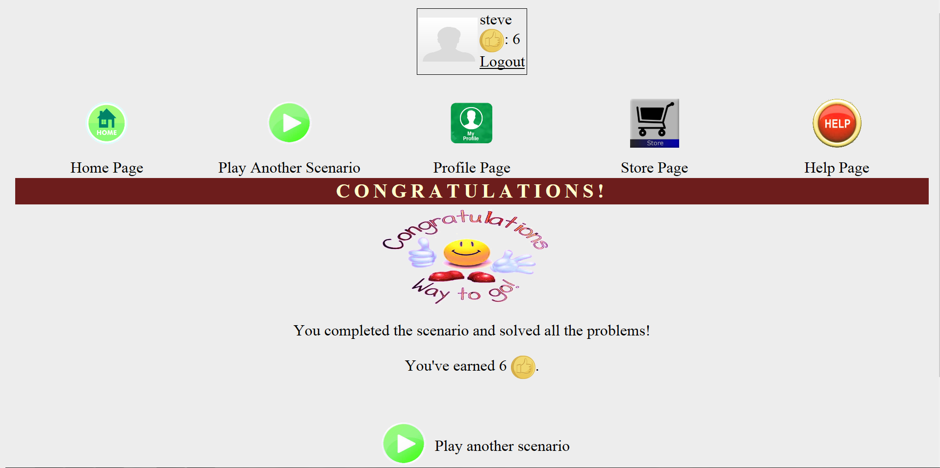





Alexander Davis
Steven Kosovich
Timothy Leikam
Gregory Martini
Team PLUVALI
Coping Skills Game
Play a fun game to get tokens to improve your profile, while learning invaluable coping skills at the same time!

Slide 2


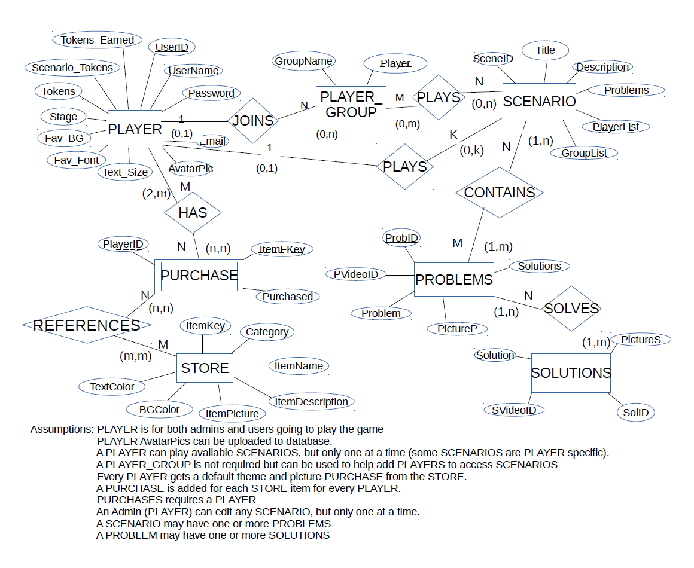
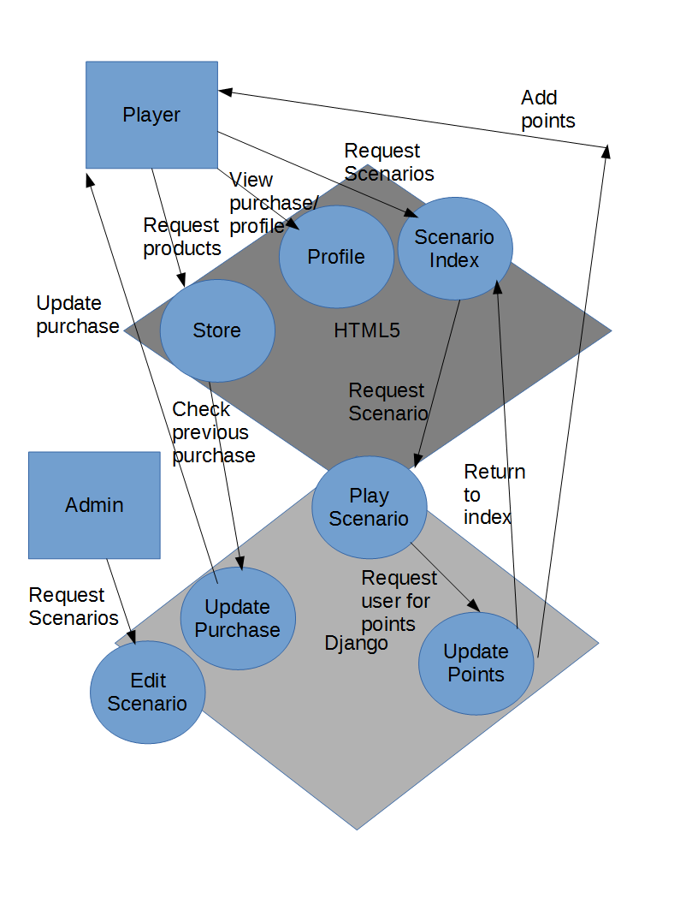
Alexander Davis
Steven Kosovich
Timothy Leikam
Gregory Martini
Team PLUVALI
Coping Skills Game

